Slide 1

DA 204o: Data Science in Practice Course Project Proposal Predicting Customer Satisfaction based on various parameters present in E-Commerce dataset
Rahul Rai, CISCO-IISC, rahulrai@iisc.ac.in
Mukunda Saiteja Annam, CISCO-IISC, mukundaannam@iisc.ac.in
Manoj Kumar Yelamarthi, CISCO-IISC, manojyk@iisc.ac.in
T Senthilkumar, CISCO-IISC, senthilkuma1@iisc.ac.in

Slide 2
Problem Definition
Background of the problem
E-commerce is growing rapidly, and understanding what factors affect customer satisfaction, as expressed in ratings and reviews, is essential for any business.
Online reviews are an important part of the customer journey and can influence future purchases.
Why is it important?
Customer Satisfaction has direct implication towards company sales. By improving customer satisfaction there will be increase in company future sales.
Objectives of the project
The objective of this project is to analyze the Brazilian E-Commerce Public Dataset on Kaggle to determine customer satisfaction.
How can Data Science solve the problem?
Data science can be used to analyze the relationship between various parameters like delivery time, price, product etc… against customer ratings. This can be done by using techniques of machine learning.
By identifying the factors that most influence customer ratings, businesses can take steps to improve and increase customer satisfaction.
This project seeks to investigate the relationship between various parameters (like delivery time, price, product etc) against customer satisfaction within the e-commerce landscape.

Slide 3
Data Collection and Preparation
Data Sources and Data Models:
Primary Data: The Brazilian e-commerce dataset provided by kaggle.(Dataset)
Data Model: olist_customers_dataset, product_category_name_translation,olist_sellers_dataset,olist_products_dataset,olist_orders_dataset,olist_order_reviews_dataset,olist_order_payments_dataset,olist_order_items_dataset,olist_geolocation_dataset, olist_customers_dataset
SIZE: 45MB
Records- Around 95K
Years – 2 years
Any preprocessing steps required- not required

Slide 4
Proposed Methodology
Overview of methods or models used:
Logistic Regression
Decision Tree
RandomForest
Justification for choosing these methods:
It's well-suited for binary classification tasks.
It handles complex and non-linear data relationships.
It manages high-dimensional data effectively.
It provides feature importance to help understand the drivers of satisfaction
It is robust to missing and noisy data, ensuring good performance and generalization.
Python, Libraries:
Pandas, Numpy, Seaborn, matplotlib, sklearn, statsmodels

Slide 5
Implementation Plan
Project phases (data collection, model building, testing)
Data Collection and Preprocessing : Collect, clean, and prepare the data for model building.
Exploratory Data Analysis (EDA) : Explore the dataset to understand relationships between features and target variables.
Model Building : Train machine learning models and fine-tune hyperparameters if any.
Testing and Model Evaluation : Test the model on unseen data and validate its performance.
Deployment and Reporting : Deploy the model and report key findings.
Timeline and milestones
Data Collection and preprocessing : 1-2 weeks
Exploratory Data Analysis : 1 week
Model building : 1-2 weeks
Testing and model evaluation : 1 week
Deployment and reporting : 1 week
Resources required
Python environment with libraries (pandas, scikit-learn), compute resources (local/cloud), data sources (e-commerce dataset).

Slide 6
Challenges and Risks
Potential difficulties you might face
Identifying features that determine target variable.
Imbalance in classes
How you plan to mitigate them
By correlating the features with target variable

Slide 7
Expected Outcome
What do you expect to achieve?
The goal is to build a predictive model that accurately classifies customer satisfaction based on various factors like payment value, delivery time, and product price, leading to actionable insights for improving customer service.
How will you measure success?
Success will be measured by the model’s accuracy, precision, recall, and F1-score on the test dataset.

Slide 8

Role and Responsibilities
Student 1:
Methods of ML models to apply, Model development
Student 2:
Data Preparation and pre-processing, Model development
Student 3:
Analysis and increasing the F1 score Validation & Model development
Student 4:
Validation & Model development
Note: More than one student may be responsible to handle an activity, e.g., Model development.

Slide 9
Data Science Canvas |  |  | Project: | Predicting Customer Satisfaction based on various parameters present in E-Commerce dataset
 |  |  | Team: | Rahul Rai, Mukunda Saiteja Annam, Manoj Kumar Yelamarthi, T Senthilkumar
Problem Statement |  |  |  | Execution & Evaluation |  | Data Collection & Preparation
Business Case & Value Added Which business case should be analyzed and what added value does it generate? Business Case – Customer Satisfaction Understanding customer satisfaction will help company to increase their sales. | Model Selection Which analysis methods can be considered on the basis of the specific data landscape and the business case? Binary Classification Problem. | Model Requirements Which model requirements must be complied with in order to obtain a valid model? Logistic Regression Decision Tree Random Forest | Skills What skills are needed to provide the data and model development? Data cleaning, data transformation, exploratory data analysis. Feature engineering, model selection, hyperparameter tuning. Python libraries like pandas, matplot, seaborn, scikit-learn | Model Evaluation Which indicators require quality control and validation and how should they be interpreted? Is real-time monitoring necessary? measured by the model’s accuracy, precision, recall, and F1-score on the test dataset. | Data Storytelling What requirements does the target group have for the presentation of the results and how do I effectively communicate this data? Clear insights, actionable recommendations, and simple visuals to support decision-making. Effective communication: use visuals (box plot, graphs) to highlight key relationships. | Data Selection & Cleansing Which of the available data is relevant? Do the data have to be cleaned up? Relevant data: delivery_time,payment_value,freight_value,price,is_reviewed Data cleaning: null & duplicate rows removed. Outliers removed from delivery_time. | Data Collection How and with which methods should additionally required data be collected? What properties has this data to fulfil? Methods: used to_datetime() to convert date field into datetime. Using this we got additional fields delivery_time, delivered_on_time as feature.
Data Landscape Which data is required for this and which is already available? Which additional data has to be collected? Required – customer_satisfaction Available – payment_value, freight_value Additional – delivered_on_time, delivery_time |  | Software & Libraries Which software should be used? Is there already a standard solution? Which libraries are used? Software – python, jupyter notebook There is no standard solution. Libraries – matplotlib, seaborn, scikit-learn, pandas, numpy |  |  |  | Data Integration In which system should the data from different sources be migrated? NA | Explorative Data Analysis Are there outliers or structures to be considered? Creation of descriptive key figures for the first assessment of the data. Yes there was outliers in delivery_time which was removed using 95th percentile.
Adopted from: https://github.com/tomalytics/datasciencecanvas

Slide 10
Data Cleaning and Preprocessing
Removed Missing Values: Used .dropna() to remove rows with missing values in the orders.
Removed Duplicates: Used .drop_duplicates() on order_items & reviews to ensure each order ID has unique entries.
Filled Missing Values: Replaced null values in the review_comment_message column with an empty string '' using .fillna().
Converted Date Columns: Transformed order_purchase_timestamp, order_delivered_customer_date, order_delivered_carrier_date, and order_estimated_delivery_date columns to a uniform date format for consistency using to_datetime().
Created Positive Review Indicator: Added a column is_reviewed to identify reviews with a score of 5 and a non-empty review comment.
Encoded Customer Satisfaction: Introduced a binary target column customer_satisfaction to label scores above 4 as satisfied (1), otherwise not satisfied (0).

Slide 11
Feature Engineering
Delivery Time Calculation: Added a delivery_time column to compute the difference (in days) between order_delivered_customer_date and order_purchase_timestamp.
On-Time Delivery Indicator: Created a binary feature delivered_on_time to indicate whether the delivery occurred on or before the order_estimated_delivery_date.
Shipped on Time: Added a column shipped_on_time to check if the order_delivered_carrier_date was before or equal to the shipping_limit_date.
Joined DataFrames: Combined order_reviews, orders, order_items, and order_payments using successive .merge() operations on the order_id.

Slide 12
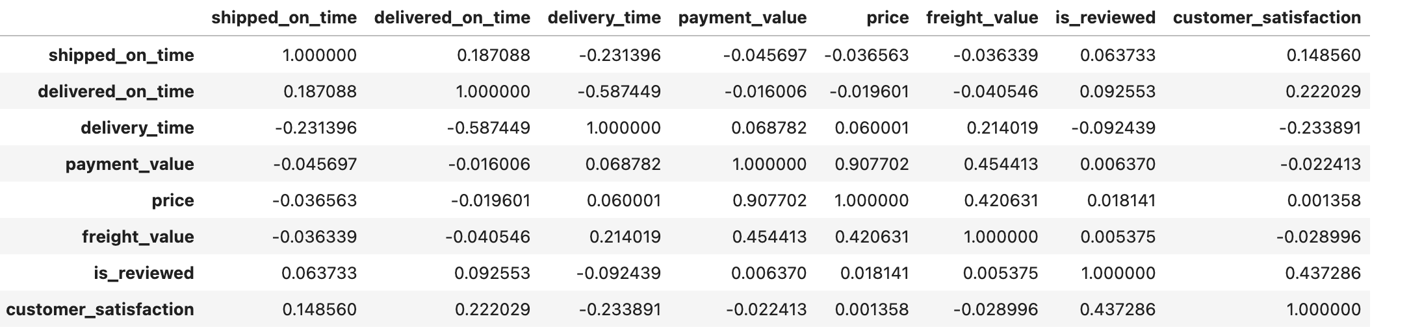
Feature Selection
Below are the features that are used for customer satisfaction:
shipped_on_time
delivered_on_time
delivery_time
payment_value
freight_value
price
is_reviewed
Note: payment_value and freight_value are continuous variables which we analyzed using binning methods, but it did not improve performance so we used the same continuous values in our model.

Slide 13
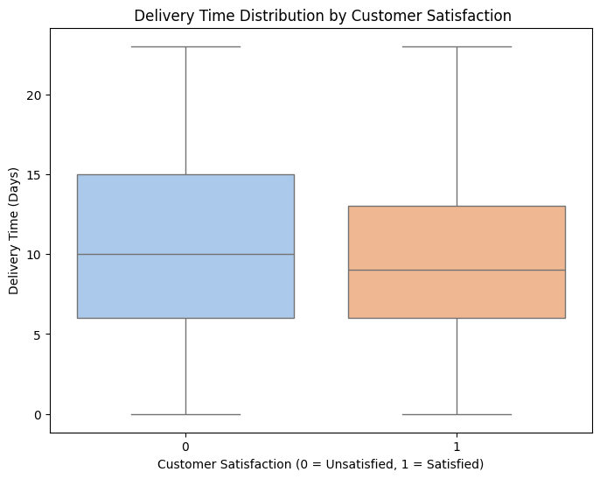
Delivery Time Analysis
Delivery time data was analyzed to understand its relationship with customer satisfaction. The box plot visualizes delivery time distribution by customer satisfaction:
Class 0 (unsatisfied): Higher variability in delivery time, with higher median values.
Class 1 (satisfied): Lower median delivery time, indicating faster delivery leads to satisfaction.
Outlier Found & Removal:
Delivery time beyond 95th percentile were identified as outliers.
These outliers were removed to ensure robust analysis & avoid skewing results.
Key Insight: Shorter and consistent delivery times strongly correlate with higher customer satisfaction.

Slide 14
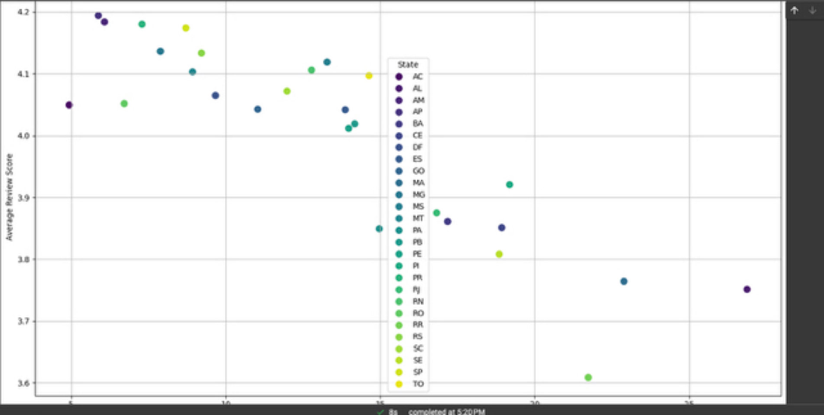
Average review score per state

Slide 15
Model Training and Optimization
This is a classification problem so we used following models to predict customer satisfaction:
Logistic regression
Decision tree classifier
Random forest classifier
Gradient boosted classifier
Out of this HistGradientBoostingClassifier was used as it gave us better performance compared to other algorithms. The dataset was split into training and test sets (80%-20%).
GridSearchCV was used for hyperparameter tuning with the following parameters:
'max_iter': [100, 200, 300],
'max_depth': [None, 3, 5],
'learning_rate': [0.01, 0.1, 0.2],
'min_samples_leaf': [10, 20, 30]

Slide 16
Results
Model Accuracy: 68%
Precision, Recall, and F1-Score for each class:
Class 0 (Unsatisfied): Precision = 0.59, Recall = 0.48, F1-Score = 0.53
Class 1 (Satisfied): Precision = 0.72, Recall = 0.80, F1-Score = 0.75

Slide 17
Challenges Faced and Solutions
Challenge: Initially we found there was imbalance between classes 0 (unsatisfied) and 1 (satisfied).
Accuracy with imbalance class: 82%
Class 0: Precision = 0.44, Recall = 0.27, F1-Score = 0.33 (Support: 3276)
Class 1: Precision = 0.85, Recall = 0.93, F1-Score = 0.89 (Support: 14907)
This was due to we were considering “>=4” review scores as ‘satisfied’, resulting in more samples for class 1.
Solution: We updated the threshold to consider only “>4” review scores as ‘satisfied’.
This adjustment significantly reduced the class imbalance and improve model performance.
Resulted in a more balanced distribution and better classification metrics.

